Slide 1
Internet protocol stack
application: supporting network applications
IMAP, SMTP, HTTP
transport: process-process data transfer
TCP, UDP
network: routing of datagrams from source to destination
IP, routing protocols
link: data transfer between neighboring network elements
Ethernet, 802.11 (WiFi), DOCSIS
physical: move bits from one node to the next
application
transport
network
link
physical
Notes:
The services that a layer offers to the layer above is called service model of a layer. Just as in
the case of our letter delivery example, each layer provides its service by (1) performing certain actions within
that layer and by (2) using the services of the layer directly below it.

Slide 2
Internet protocol stack
Application layer:
where network applications and their application-layer protocols reside
includes many protocols such as IMAP, SMTP, HTTP etc.
refer to the packet of information at the application layer as a message
application
transport
network
link
physical

Slide 3
Internet protocol stack
Transport layer:
which transports application-layer messages
two transport protocols: TCP, UDP, either of which can transport application-layer messages
TCP: provides a connection-oriented service
UDP: provides a connectionless service
refer to a transport-layer packet as a segment in our lectures
application
transport
network
link
physical

Slide 4
Internet protocol stack
Network layer:
which transfers network-layer packets from a source to a destination host via one or more networks
include IP and routing protocols
IP protocol: defines packet structures that encapsulate the data to be delivered; defines addressing methods that are used to label the datagram with source and destination info
routing protocol: determines the routes that packets take between source and destination
refer to a network-layer packet as a datagram or packet
application
transport
network
link
physical

Slide 5
Internet protocol stack
Link layer:
which delivers the frames to the next node along the route
link-layer protocols include Ethernet, WiFi etc
refer to a link-layer packet as a frame
application
transport
network
link
physical

Slide 6
Internet protocol stack
Physical layer:
which delivers the individual bits within the frame from one node to the next
protocols in this layer depend on the actual transmission medium of the link (for example, twisted-pair cooper wire, single-mode fibre optics)
data in this layer consists of stream of bits where the bitstream may be grouped into symbols
application
transport
network
link
physical

Slide 7
ISO/OSI reference model
Two layers not found in Internet protocol stack!
presentation: allow applications to interpret meaning of data, e.g., encryption, compression, machine-specific conventions
session: synchronization, checkpointing, recovery of data exchange
Internet stack “missing” these layers!
these services, if needed, must be implemented in application
application
transport
network
link
physical
application
presentation
session
transport
network
link
physical
The five-layer Internet protocol stack
The seven-layer OSI/ISO
reference model

Slide 8

Encapsulation
source
message
M
application
transport
network
link
physical
segment
H_{t}
M
H_{t}
datagram
H_{n}
H_{n}
H_{t}
M
frame
H_{l}
H_{n}
H_{t}
M
link
physical
Transmit: encapsulate
Receive: decapsulate
switch
destination
H_{n}
H_{t}
M
network
link
physical
M
application
transport
network
link
physical
H_{l}
H_{n}
H_{t}
M
H_{n}
H_{t}
M
H_{t}
M
H_{n}
H_{t}
M
H_{l}
H_{n}
H_{t}
M
router

Slide 9
Encapsulation in practice
HTTP Header
Web Page
Web Server
TCP Header
HTTP Header
Web Page
TCP
TCP Segment
IP Header
TCP Header
HTTP Header
Web Page
IP
IP Datagram
Ethernet Header
IP Header
TCP Header
HTTP Header
Web Page
Ethernet Trailer
Ethernet
Ethernet Frame
Notes:
It is important to understand that when data is sent, it gets passed down the stack and each layer adds its own header. At the receiver side, the headers get stripped off one at a time, layer by layer, as the data is sent back up to the Application layer.

Slide 10
The Internet Hourglass
HTTP, FTP, RTP, IMAP, Jabber, …
Single Internet-layer module (IP):
Allows arbitrary networks to interoperate
Any network technology that supports IP can exchange packets
Allows applications to function on all networks
Applications that can run on IP can use any network
Supports simultaneous innovations above and below IP
But changing IP itself, i.e., IPv6, is very hard
TCP, UDP, ICMP
There is just one network-layer protocol, IP.
The “narrow waist” facilitates interoperability.
IPv4
Ethernet, 802.11x, DOCSIS, …
Fiber, Coax, Twisted Pair, Radio, …

Slide 11
Layering sometimes can be harmful
Lower performance due to data and processing overhead added by protocol headers
Sometimes header bytes >> actual content
The same functionality may be duplicated by different layers
Lack of transparency in lower layers hinders optimization

Slide 12
Summary of protocol layers
Basic Principles of layered architectures
Layering is used to separate communication functions and concerns
Each layer is responsible for different tasks
A lower layer offers a service to the layer above
Layering benefits:
Manage complexity
Modularity
Extensibility
Internet protocol stack & OSI reference model
Encapsulation
Data Units between the layers
Layering can be harmful

Slide 13
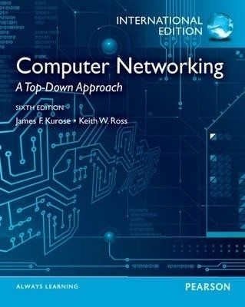
Week 1 & 2: summary
We’ve covered a “ton” of material!
Internet overview
what’s a protocol?
network edge, access network, core
packet-switching versus circuit-switching
Internet structure
performance: loss, delay, throughput
layering, service models
history (not covered. Please read the recommended book if you are interested)
Chapter 1
You now have:
context, overview, vocabulary, “feel” of networking
more depth, detail, and fun to follow!
Notes:
The recommended book is really a good one. It covers all the content that we teach in this course. I suggest you read it if there are something that you don’t understand after you listened to the lectures.

Slide 14
Additional Week 2 slides

Slide 15
Supplementary materials
Q: what is the difference between Internet protocol stack and TCP/IP protocol stack?
The Internet protocol stack is also known as TCP/IP protocol stack or simply TCP/IP because of the two most important and foundational protocols, i.e., TCP and IP.
Q: why do I find some books saying that Internet protocol stack has four layers?
Different authors have interpreted the TCP/IP model differently. In the four-layer Internet model, the lowest layer simply combines the physical and data link layer of the OSI reference model. In this link, there is a table (also shown in the next slide just in case the link doesn’t work) which shows various network models where the number of layers varies. (source: Wikipedia).

Slide 16
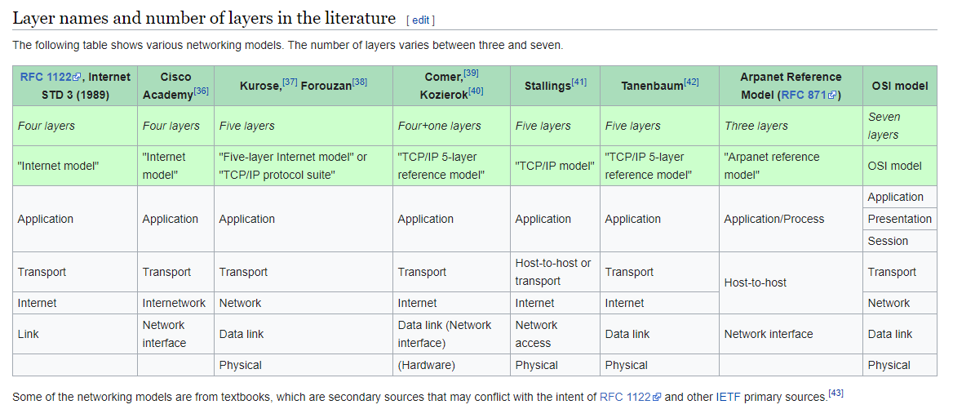
Supplementary materials
the model we are using
Source: Wikipedia

Slide 17
Thanks!

